Slide 1

Course Registration System
Group -D

Slide 2
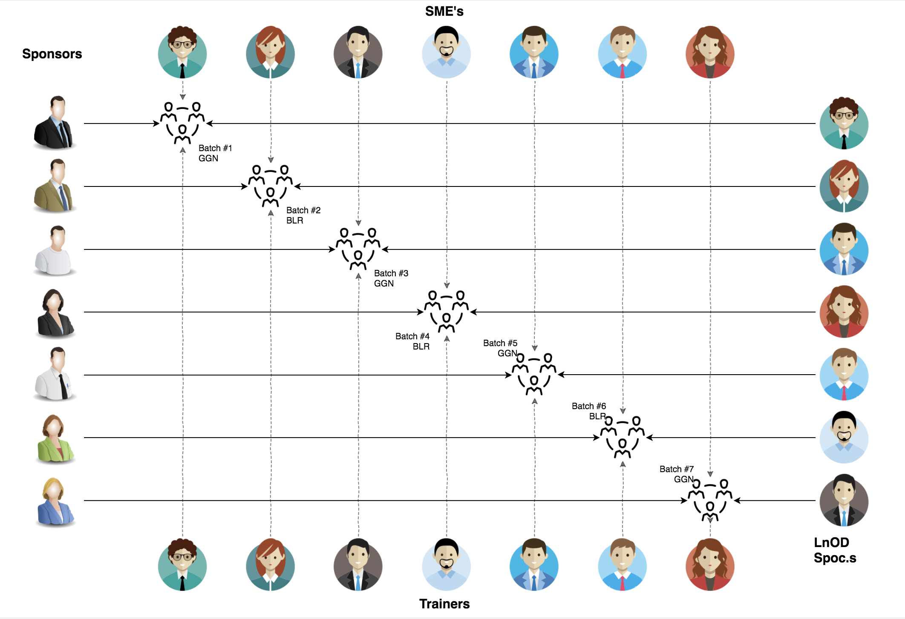
Stakeholders
1. Sponsors Signify Team
2. SME’s Amit Balyan
3. Coordinator
Seema Sandeep Shwetha Kumari

Slide 3
14 days & the D day
3 weeks plan
Everyday Discussion about topics / Technologies/ doubt clearance .
Every day with SME/Trainer discussion of Project progress & transformation based on backend Technologies
Special thanks to our Coordinators for arranging such an amazing training :
Seema Sandeep
Amit Balyan
Shwetha

Slide 4
The Ask – here we started
1. Identified the key features and functionalities of the application that we wanted to buid 2. Decide on the architecture and design of the application 3. Created a roadmap and set realistic timelines for development 4. Divided the workload among team members and assigned tasks accordingly 5. Begun with developing the application, starting with learning the basic of each application and implementing it 6. Our Mentor regularly reviewed the progress and suggested adjustments as needed Communicate effectively with team members and stakeholders 7. Continuously learned and improved as a team during our whole journey.

Slide 5

Our Team
Notes:
Time – 2 mins

Slide 6

Sukhmanpreet Kaur
Al Rahima Lari
Tejasvini S J
Nidhi Sharma
Sundar Rajan
Vishnu Priya

Slide 7
And the Journey Began . . . .
Notes:
Time – 1 min
Swati

Slide 8

Our Journey
Notes:
Time - 2 mins

Slide 9
3 WEEKS OF TRAINING + PROJECT DEMO
15 DAYS
360 HOURS
21600 MINUTES
1296000 SECONDS
LIMITLESS KNOWLEDGE

Slide 10
CRS
Mindset
Process
5
CRS Project
Tools
4
Adapting to a developer
Mindset
Comprehend
3
Design Thinking
2
Decide the Technologies JAVA/REST
1
Understanding Project Goals

Slide 11
 | Module | Details
Week 1 | Understanding problem statement. GIT UML Diagrams | Knowing Git commands and Unix commands Understanding requirements
Week 2 | Java 8 or 11 Exceptional Handling MySQL | Developing a POS application with : MySQL and Java. Comprehending the features and collections of Java 8/11
Week 3 | SpringBoot REST API Angular 13 | To create a POS application and REST API Using Java for Course Registration System.
Notes:
Product Thinking (Design Thinking, Requirement Analysis, )
Multi Skilled (Frontend, Backend, DevOps)
Fast Decision Making (Agile)
Increasing the Pace (Automation CI/CD)
Startup Mindset (Agile)
Continuous Improvement (Retros)

Slide 12
Team members | Responsibility
Al Rahima Lari | Student Functionalities, Database Functionalities
Sukhmanpreet Kaur | Admin Functionalities , Student Functionalities
Nidhi Sharma | Admin Functionalities , User Functionalities
Tejasvini S J | Professor Functionalities, Payment Functionalities
Sundar Rajan | User Functionalities , Course Functionalities
Vishnu Priya | Database Functionalities, Payment Functionalities

Slide 13

Our goal was to create a high-quality student registration system that exceeds the expectations of both students and college staff. Through collaboration and utilizing our diverse skillsets, We were able to deliver a seamless and efficient registration process that enhances the student experience.
Notes:
Time – 3 mins

Slide 14




Our Vision
" As a team, our vision for developing this full stack project on a
Student Registration System
for a college that could create a comprehensive and efficient system that simplifies the registration process for students and minimizes administrative workload for the college staff “
1
2
Quality
Security
3
4
Interactivity
Speed
Notes:
User satisfaction and brand value

Slide 15

Engineering Practices
Notes:
Time – 5 mins

Slide 16
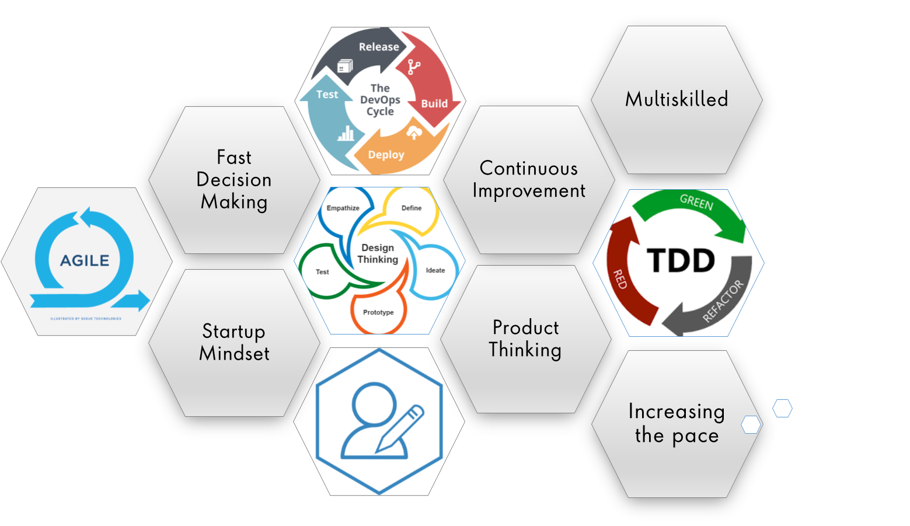

Slide 17
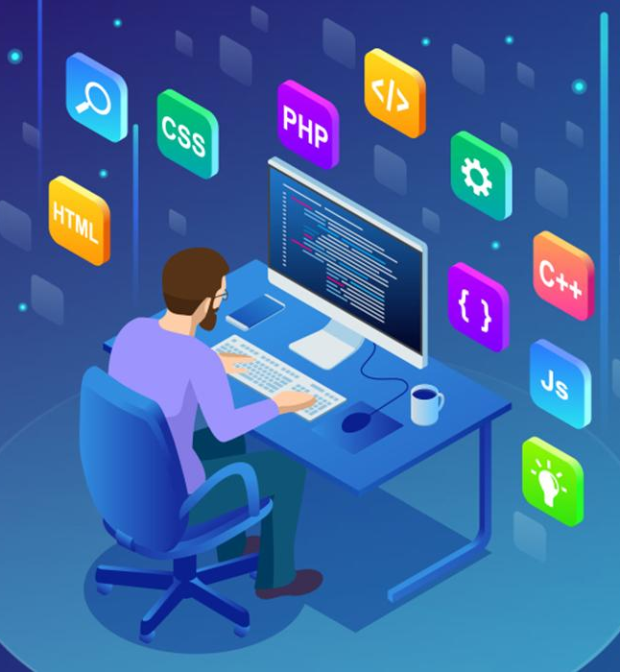
Tech Stack
Notes:
Time – 2 mins

Slide 18










Backend
Data
Code Editor
Frontend
Core Language
SQL Database
Visual Studio Code
Open Source
Framework
Spring Application
API Platform
Notes:
Time – 1 min

Slide 19

Development
Notes:
Time – 1 min

Slide 20
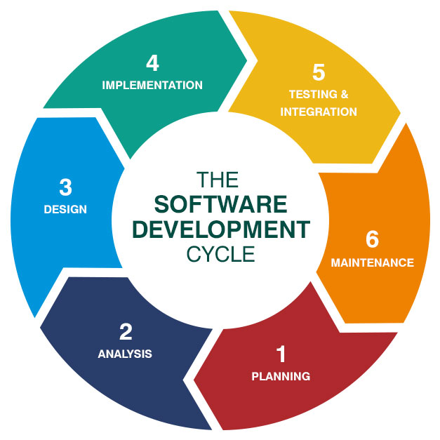

Slide 21

Challenges & Learnings
Notes:
Time – 2 mins

Slide 22


Slide 23

Demo
Notes:
Time –
Architecture – 5 mins
NFR Dashboard – 3 mins
Demo – 10 mins
1. Show the Responsiveness and Wave tool first

Slide 24

Questions
Notes:
Time - ?

Slide 25
Thank you
Notes:
Time – After this show the testimonial video. 1 min

